Slide 1


Cloud Native Architectures and Frameworks
March 2016
Notes:
IMPORTANT PREPARATION
Create a digital-arch organization with spaces 1-Dev, 2-Test, and 3-Prod spaces
Use the “Setup a Space” instructions to create apps and services in all three spaces and import initialization data
Delete payments-service app instance from the digital-arch 1-Dev space
Delete scale-gold service, if there
Open App Manager to the org digital-arch and space 4-Prod
Start up the payments app from the 4-Prod space to demo app
Open terminal window to “cf target –o digital-arch –s 1-Dev”
Open STS to api-gateway (payments) app and open index.html and styles.css
Ensure connection to Jenkins service is good. (https://cbusch.ci.cloudbees.com)
Open https://papertrailapp.com
Setup a space
In a terminal window, navigation to the mc_source home directory
Connect to a CF instance org and space with Auto-scale, MySQL and RabbitMQ tiles
Run one of the deployment scripts
./deploy-dev.sh – route host names end with “-dev”
./deploy-test.sh – route host names end with “-test”
./deploy-prod.sh – route host names are the app names
Apps consumer-messaging-server, payment-service and payment-history-service are bound to separate databases and need initialized
consumer-messaging-server
open the phpmyadmin-consumer app details view
use service credentials of bound MySQL service
open the phpmyadmin-consumer app and use creds from bound service
click on the database “cf_xxxx” then click Import import the DDL from ConsumerMessagingWS src/main/resources/data/ddl.sql
Click the push_notif_config table then the Query tab and past the contents of the ConsumerMessagingWS src/main/resources/data/data.sql into the field and click Go to import the data
payment-history-service
open the phpmyadmin-pay-hist app details view
use service credentials of bound MySQL service
open the phpmyadmin-pay-hist app and use creds from bound service
click on the database “cf_xxxx” then click the payment table
click the Query tab and import the payment-history-service src/main/resources/import.sql and click Go to import the data
payment-service
use the same instructions above for the payment-service so that it contains the same data as payment-history-service
Create Jenkins “Payment app test project”
Add a Post Action to call the production script if build successful
Create Jenkins “Payment app prod project”

Slide 2
Agenda
Why?
What?
How?

Slide 3
WHY?

Slide 4






Software is changing industries

Slide 5

$44B market cap
37% of US internet traffic
Forbes 27th most innovative company
Netflix, an undisputed business & technology leader
34% of peak N. American internet traffic from 6-9pm
If speed was why they won, microservices was how
Quickly responds to customer experience (Value)
Resilient to outages (Quality/Consistency/Durability)
Notes:
While NetflixOSS is a talent acquisition and retention strategy, they are in the movie business 1st, and the software business 2nd.
Open source and supporting their developer’s efforts in the industry is how they are able to attract and retain the best engineers, giving them the ability to continue inventing all this stuff. That’s tough to duplicate.
Detail on Netflix quote: Netflix needed the performance, stability, concurrency of the JVM, but was searching the right RAD capability to give them the velocity they wanted.

Slide 6

CLOUD NATIVE
Agile
Lean
Continuous
Delivery
Microservices
Cloud
DevOps
Notes:
At Pivotal, we really see these trends as manifestations and facets of the same thing – that we call CLOUD NATIVE.
CLOUD NATIVE is the coming together of tools, frameworks and building modern software on a cloud infrastructure

Slide 7
The promise of Cloud Native
Deploy new features daily to production
Automate middleware
Free/Cheap horizontal scaling
Contract between App & Platform
Notes:
That is and should be a governing principle behind any cloud platform, library, or tool. Spring Cloud–an open-source library–makes it easy to develop JVM applications for the cloud. With it, applications can connect to services and discover information about the cloud environment easily in multiple clouds such as Cloud Foundry and Heroku. Further, you can extend it to other cloud platforms and new services.
Application Framework
Spring Cloud : used by Netflix
Spring Boot now over 1M downloads a month, historic levels of growth
Runtime platform
Cloud Foundry elastic runtime used by top FS leaders
Enterprise production ready Linux Container based platform
Infrastructure Automation
CF BOSH: Embedded OS, cloud API integrated
Incredible operational leverage; machine to machine automation

Slide 8
WHAT?

Slide 9
Characteristics of Cloud Native Architectures
Continuously Delivered
Twelve Factor Apps (http://12factor.net/)
Microservices
Self-Service agile infrastructure
API-based collaboration
Anti-fragility
Notes:
Continuously Delivered
Twelve Factor Apps (http://12factor.net/)
Microservices
Self-Service agile infrastructure
API-based collaboration
Anti-fragility

Slide 10
Enabling Continuous Delivery
Development
Operations
Idea
Business
Customer
$
Value
QA
Companies that disrupt, reduce time to value

Slide 11
Enabling Agile Delivery
Behavior Analytics
Design
Development
Customer Feedback
Test
Customer Delivery

Slide 12
Conway’s Law
“Any organization that designs a system (defined broadly) will produce a design whose structure is a copy of the organization's communication structure.”
- Melvin Conway, 1967
http://www.melconway.com/Home/Committees_Paper.html
Notes:
Inverse Conway Maneuver coined by Thoughtworks - http://jonnyleroy.com/2011/02/03/dealing-with-creaky-legacy-platforms/
Goal is to create self contained, business aligned teams with the smallest feedback loop.
Business capability teams interact with platform operations team via APIs and not meetings. This creates a friction free experience for the business capability team who now have the tools to

Slide 13
Inverse Conway Maneuver Enable Continuous Delivery
Product Mgr.
Dev
UX
QA
DBA
Self
Service
APIS
Sys Admin
Network Admin
Storage Admin
Business Capabilities Team Using Microservices
Platform Operations Team
http://jonnyleroy.com/2011/02/03/dealing-with-creaky-legacy-platforms/
http://www.slideshare.net/adriancockcroft/microservices-the-good-bad-and-the-ugly
Notes:
References:
Inverse Conway Maneuver coined by Thoughtworks - http://jonnyleroy.com/2011/02/03/dealing-with-creaky-legacy-platforms/
http://www.slideshare.net/adriancockcroft/microservices-the-good-bad-and-the-ugly
Notes:
Goal is to create self contained, business aligned teams with the smallest feedback loop.
Business capability teams interact with platform operations team via APIs and not meetings. This creates a friction free experience for the business capability team who now have the tools to

Slide 14
Enabling Continuous Delivery
Production Release
ORDERS
Production Release
Production Release
SHIPPING
Production Release

Slide 15
Twelve-Factor Apps
Codebase
Dependencies
Configuration
Backing Services
Build, release, run
Processes
Port binding
Concurrency
Disposability
Dev/prod parity
Logs
Admin processes
APPS
contract
Cloud Platform
Architectural and development practices – http://12factor.net
Notes:
I. Codebase
One codebase tracked in revision control, many deploys
II. Dependencies
Explicitly declare and isolate dependencies (mvn, etc.). Don’t expect servers to have them
III. Config
Store config in the environment. Could you open-source the project w/o revealing secrets?
IV. Backing services
Treat backing services as attached resources. A deploy of the twelve-factor app should be able to swap out a local MySQL database with one managed by a third party (such as Amazon RDS) without any changes to the app’s code
V. Build, release, run
Strictly separate build and run stages. Binary Integrity
VI. Processes
Execute the app as one or more stateless processes
VII. Port binding
Export services via port binding. Routing layer takes care of routes -> ports
VIII. Concurrency
Scale out via the process model
IX. Disposability
Maximize robustness with fast startup and graceful shutdown
X. Dev/prod parity
Keep development, staging, and production as similar as possible
XI. Logs
Treat logs as event streams
XII. Admin processes
Run admin/management tasks as one-off processes

Slide 16
Microservice: Definition
If every service has to be updated in concert, it’s not loosely coupled!
“ Loosely coupled service oriented architecture with bounded contexts"
If you have to know about surrounding services you don’t have a bounded context.
- Adrian Cockcroft

Slide 17
Microservices are NOT
Monolithic Application
Service
Service
HTML
JavaScript
MVC
Enterprise Service Bus
Service
Service
OR
Data Access
Service
Service
Tightly Coupled
Centralized

Slide 18







Microservice Architecture
Relational
DB
HTTP
HTTP
Key/Value
Store
HTTP
HTTP
HTTP
…
AMQP
AMQP
HTTP
Graph
DB
Notes:
REST and message-driven services
Polyglot persistence, services encapsulate data store semantics
Diversity of clients acknowledged
API Gateway for service aggregation, reduce chattiness, protocol translation, reduce latency/round-trips, deal with mobile device fragmentation, build use case/device specific API’s

Slide 19
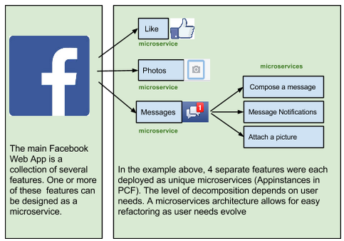
A familiar Microservice example
Notes:
Features can be added, removed, & changed independently, because they’re deployed independently.
Service outages do not affect entire site/app.

Slide 20
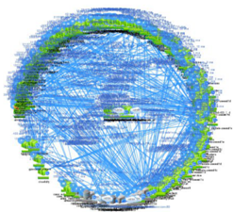
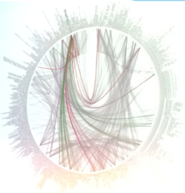

Microservices are hard

Slide 21
Challenges of distributed systems
Configuration Management
Service Registration & Discovery
Routing & Load Balancing
Fault Tolerance (Circuit Breakers)
Monitoring
Concurrent API Aggregation & Transformation
Notes:
Everybody faces these, SCS takes PCF to the next level

Slide 22
HOW?

Slide 23


Cloud Foundry Haiku
Here is my source code
Run it on the cloud for me
I do not care how

Slide 24
It takes a platform
An end-to-end platform that makes implementing distributed application best practices, a turn-key and first practice

Slide 25
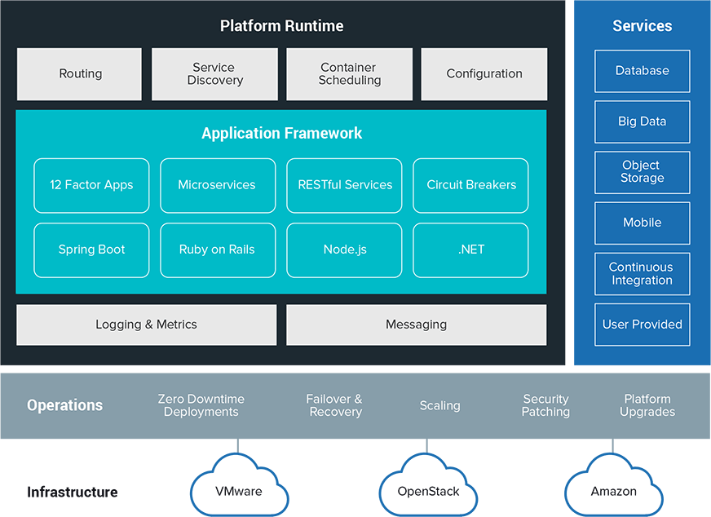

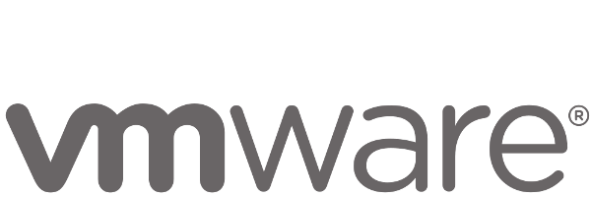
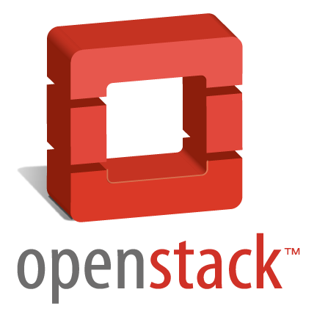
It Takes a Platform
Multi-Cloud
Infrastructure

Slide 26






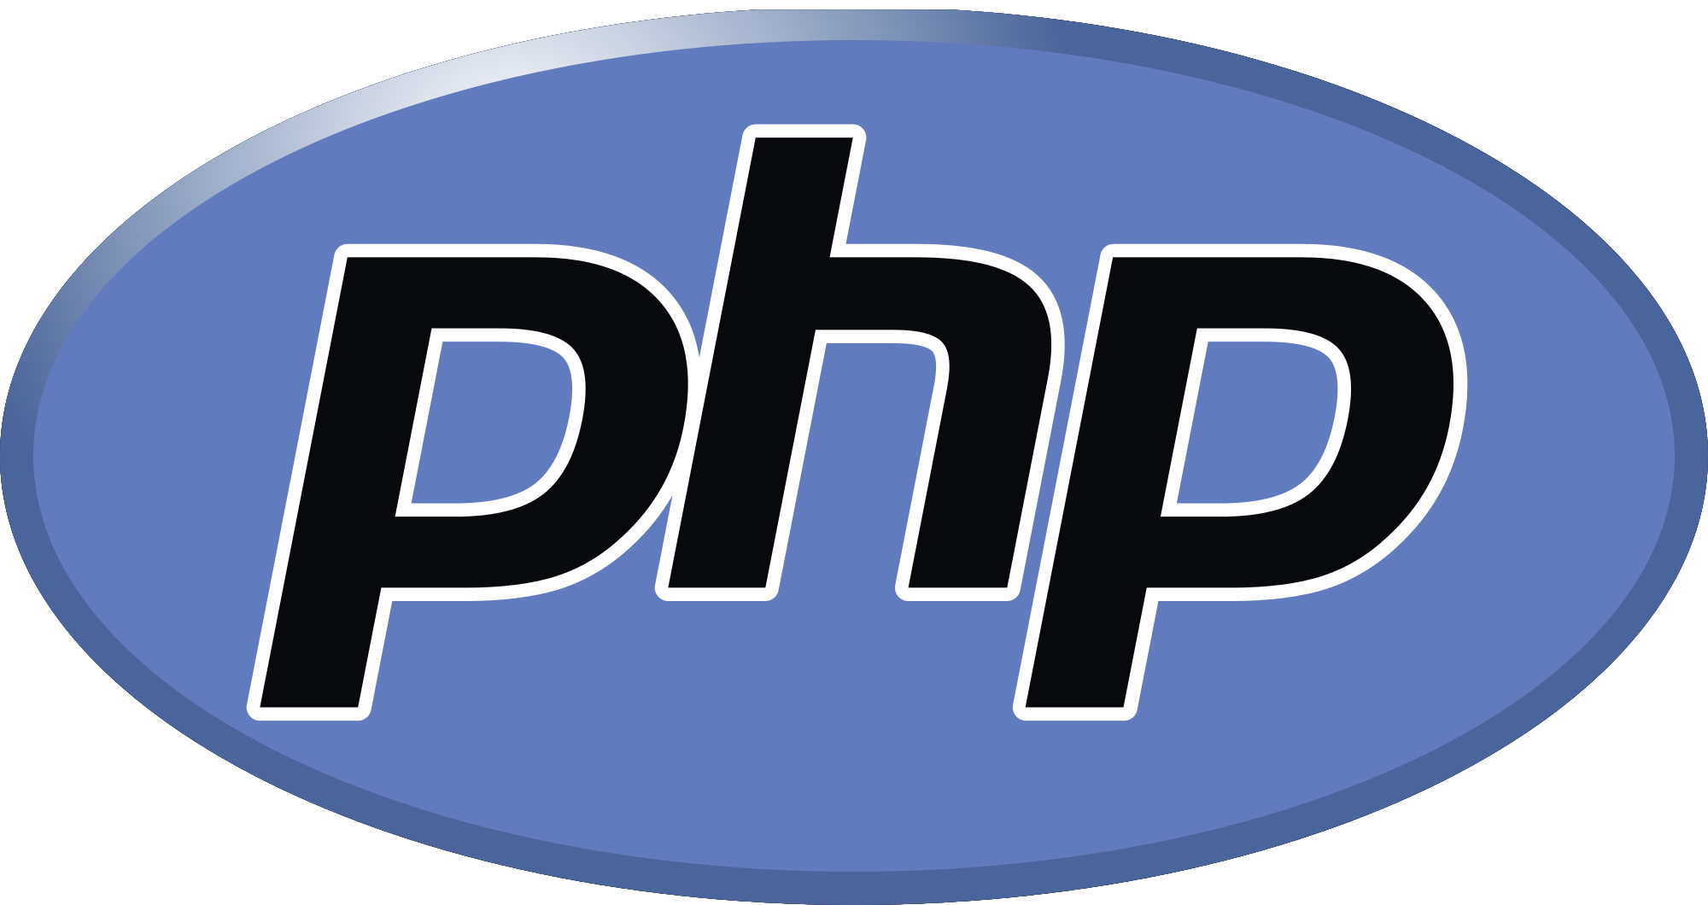

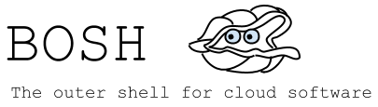
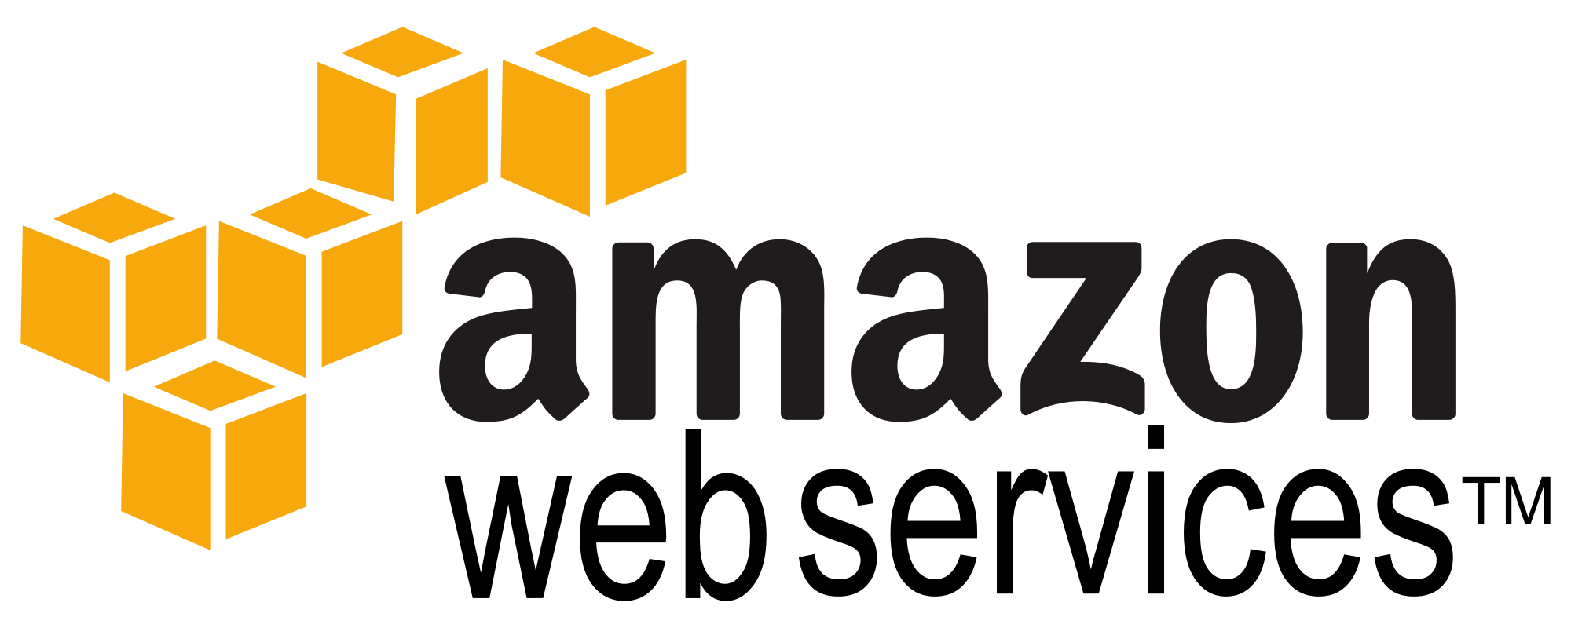
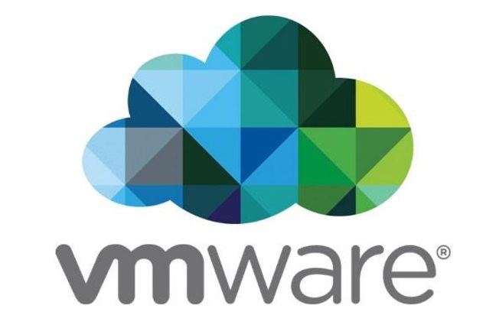


The platform for keeping promises
Application Framework
Spring Cloud
Spring Boot
Go
Dev
Contract: 12 factor app
Runtime Platform
Ops
Dev
Contract: BOSH Release
Infrastructure Automation
BOSH
Contract: Cloud Provider Interface
IT Ops
Infrastructure
Culture
Cloud Native Framework
Tools

Slide 27
Bosh Haiku
Here are my servers
Go make them a cloud foundry
I do not care how

Slide 28
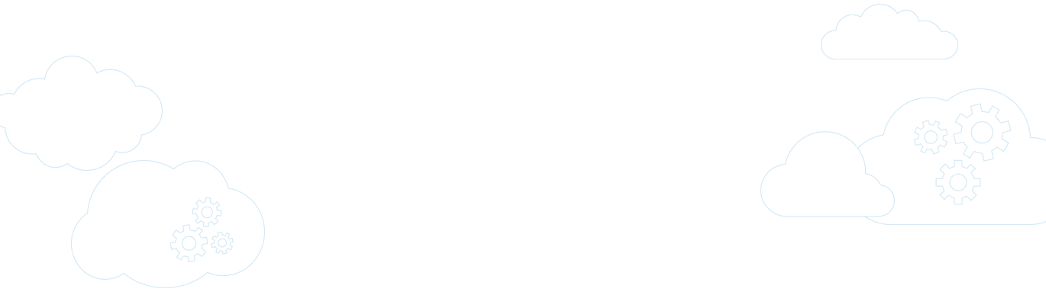

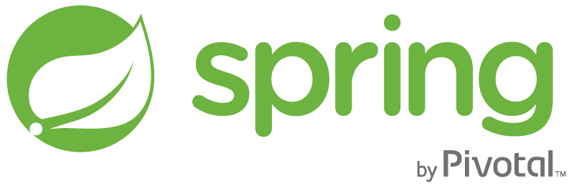
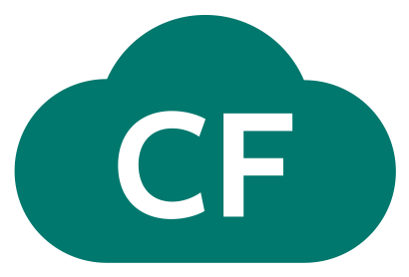
Pivotal Cloud Foundry
A complete framework for delivering software rapidly, consistently and reliably at scale.
Language frameworks designed for microservice architectures with components for service discovery, metrics, circuit breakers and more.
Application Framework
Application container runtime with production-ready backing services, automated build pipeline, routing, health management and logging.
Platform Runtime
Pivotal
Cloud Foundry
API-based infrastructure provisioning that delivers bit-for-bit, consistent, self-healing deployments across private and public cloud.
Infrastructure Automation
Pivotal
Cloud Foundry
Notes:
PCF is the 1st and only cloud native vendor available today

Slide 29

It also takes a Cloud-Native Application Framework
Spring
#1 Enterprise Java App Framework
Netflix
Open Source
Spring Boot
Quick Start
Little to no config.
Opinionated View
Spring Cloud
Distributed Config
Service Registration and Discovery
Routing/Load Balancing
Service Integration
Fault Tolerance
Pivotal is the main custodian of Spring and we hire the main committers for Spring Boot and Spring Cloud. We can bring these resources to bear to help significantly accelerate a customer’s journey to becoming a Cloud Native enterprise
Notes:
#1 Enterprise Java App Dev Framework
Used heavily by Netflix and F2000
OSS, Apache 2.0 licensed
Millions of downloads
Integrated into PCF, BDS

Slide 30



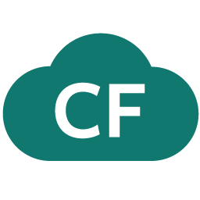
Spring Cloud
Notes:
http://www.wired.com/wp-content/uploads/2014/06/google-cloud.jpg
This is stuff we have tiles for
Ribbon and Hystrix are really client libraries – hence no tile.
This is what’s in the box for 1.0 –
Service Registry: Eureka (not any others, need something that “just works” for devs
Config Server – can use SVN, Git
Circuit Breaker – Hystrix Dashboard + turbine.

Slide 31

Companies want to be fast like Netflix
Netflix needed to be faster to win / disrupt
Pioneer & vocal proponent of microservices - the key to their speed and success
Netflix OSS supplies parts, but it’s not a solution
Difficult for enterprises to build it themselves
Pivotal offers the closest thing to “Netflix in a box” today
“
“Velocity on the JVM is the Killer App”
- Andy Glover (Netflix Eng) @ SpringOne2GX 2014 Keynote
https://youtu.be/xU267-YHN5c?t=1938
Notes:
NetFlix, an undisputed business & technology leader
34% of peak N. American internet traffic from 6-9pm
If speed was why they won, microservices was how
They pioneered / began to popularize micro service concept
All they had was Amazon EC2 back then
They had to invent a distributed platform, cloud native platform with PaaS – like features
They had to invent microservice infrastructure at the application level
All before writing one line of code that relates to the application you and I know as Netflix
NetflixOSS is a talent acquisition and retention strategy, they are in the movie business 1st, and the software business 2nd.
Open source and supporting their developer’s efforts in the industry is how they are able to attract and retain the best engineers, giving them the ability to invent all this stuff.
That’s tough to duplicate.
Detail on Netflix quote: Netflix needed the performance, stability, concurrency of the JVM, but was searching the right RAD capability to give them the velocity they wanted.

Slide 32




Spring Cloud Services Suite
Git URL for Config Repo provided via Service Dashboard (post-provisioning)
Single tenant, scoped to CF space
Config Server
Service Registration and Discovery via Netflix OSS Eureka
Registration via CF Route
Service Registry
Spring Cloud
Services
Netflix OSS Turbine + Hystrix Dashboard
Aggregation via AMQP (RabbitMQ)
Circuit Breaker Dashboard
Notes:
Config Server
Git URL for Config Repo provided via Service Dashboard (post-provisioning)
Single tenant, scoped to CF space (nothing prevents shared Git repo)
Service Binding via Spring Cloud Connector
Service Registry
Service Binding via Spring Cloud Connector

Slide 33


D e m o

Slide 34
HOW?
Do we get started

Slide 35
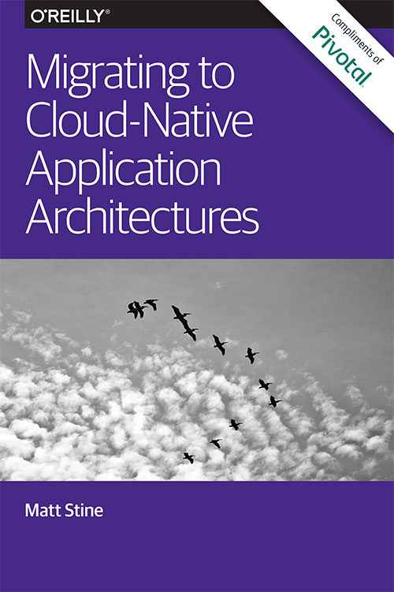
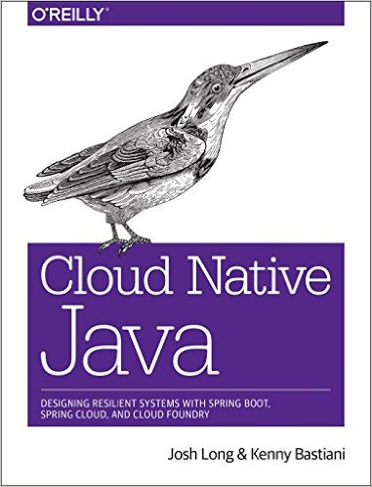
Read
By Matt Stine (@mstine)
By Josh Long (@starbuxman)
and Kenny Bastani

Slide 36
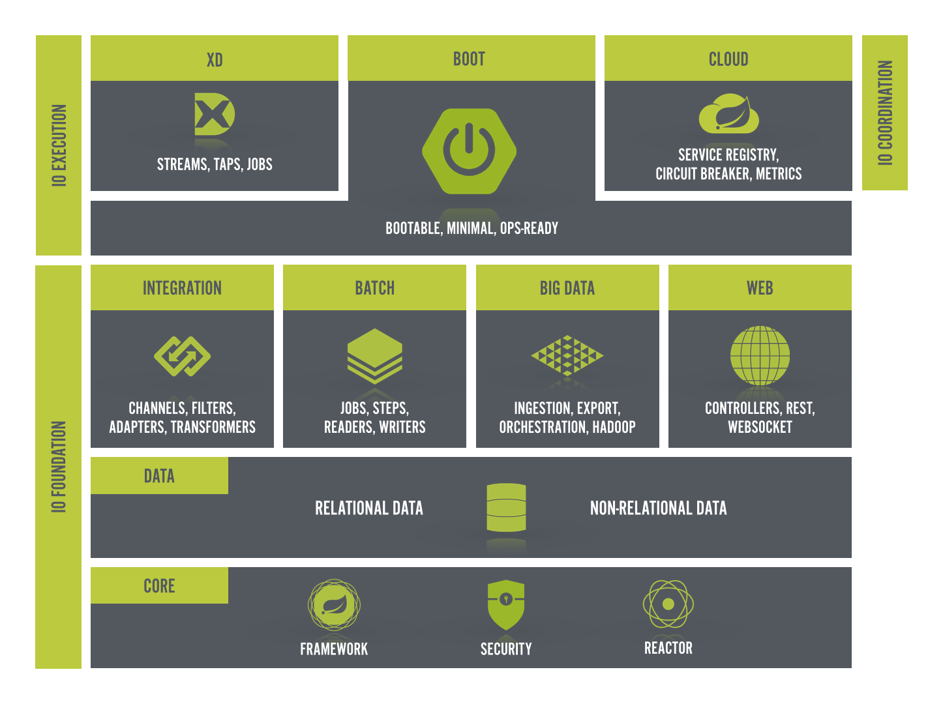
Build - http://start.spring.io

Slide 37
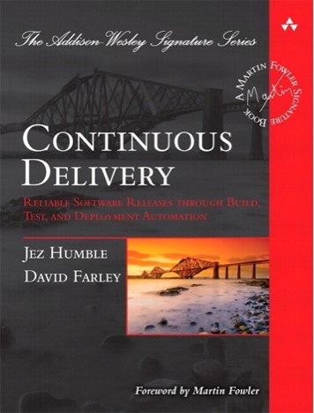
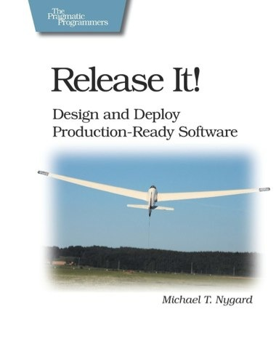
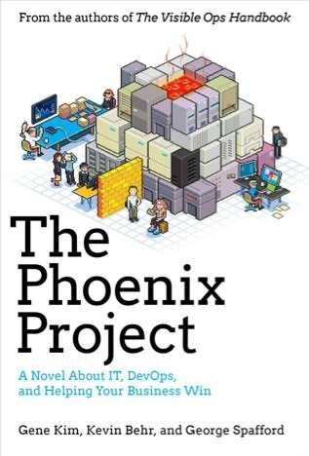
Foundations
Notes:
continuous integration of development changes
one package / many deploys
automation
deploy smaller batches more frequently
automate all testing where test failures would prevent prod release

Slide 38
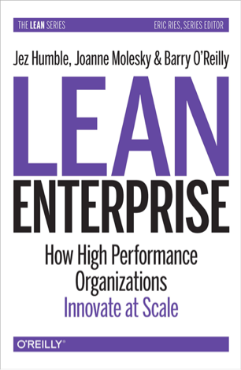
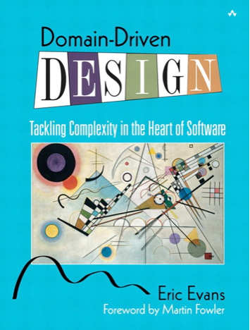
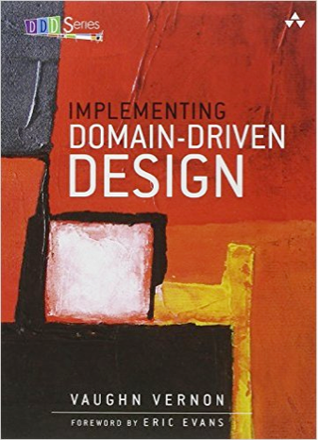
Foundations
Notes:
continuous integration of development changes
one package / many deploys
automation
deploy smaller batches more frequently
automate all testing where test failures would prevent prod release

Slide 40
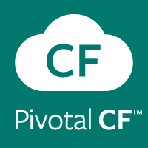

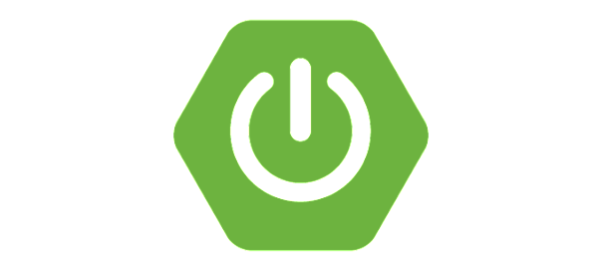

Anatomy of a Cloud Native Platform
Deployment and operations boilerplate patterns
(provisioning, deploy, security, logging, data services, etc.)
PaaS
Pivotal Cloud Foundry
Application coordination boilerplate patterns
Spring Cloud
Application Configuration boilerplate patterns
Desktop
Spring Boot
Application boilerplate patterns
Spring IO

Slide 41
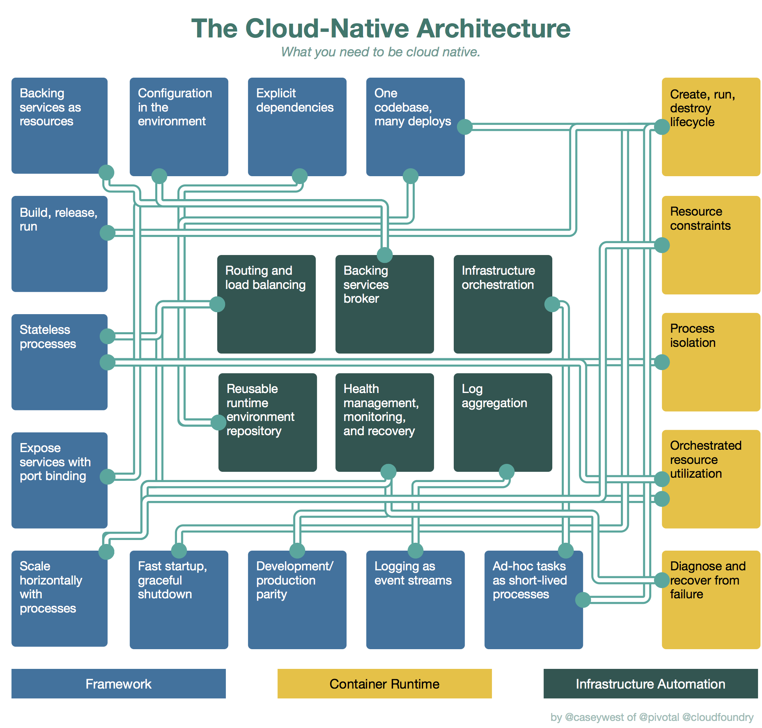
A cloud platform enables continuous delivery speed by standardizing and automating as much as possible

